Slide 1
Applied Machine Learning SEZG568/SSZG568
Dr Y V K RAVI KUMAR
yvk.ravikumar@pilani.bits-pilani.ac.in

Slide 2
Session 3(12th August,2023)

Slide 3
Session 3 – 12th August,2023
Big Picture: End-to-end Machine Learning
3.1 Model Selection and Training
3.1.1. Prediction Problem
3.1.2. Classification Problem
3.2 Evaluation
3.2.1. Prediction Problem
3.2.2. Classification Problem
3.3 Machine Learning Pipeline

Slide 4
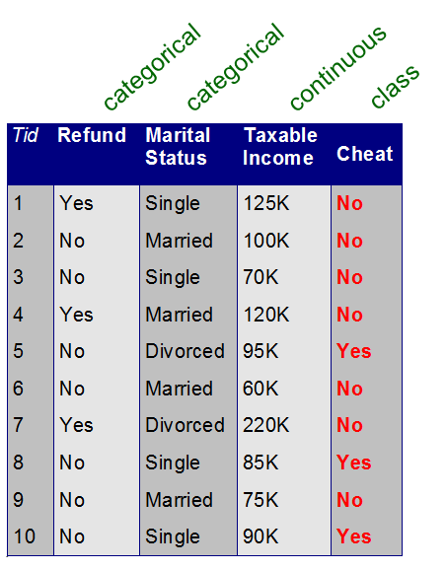
Model Selection and Training
Types of Learning
Supervised Learning
Each training tuple is supplied with the class label
Supervision:
The training data (observations, measurements, etc.) are accompanied by labels indicating the class of the observations
New data is classified based on the classifier developed using the training set
Unsupervised Learning
The class labels for the training tuples are unknown
The number of classes to be learned is not known in advance
For example, if we did not have the loan decision data available for the training set, we could use clustering to try to determine "groups of related tuples"
These groups may correspond to risk groups within the loan application data
Source: Data Mining Concepts & Techniques by Han, Kamber, & Pei

Slide 5
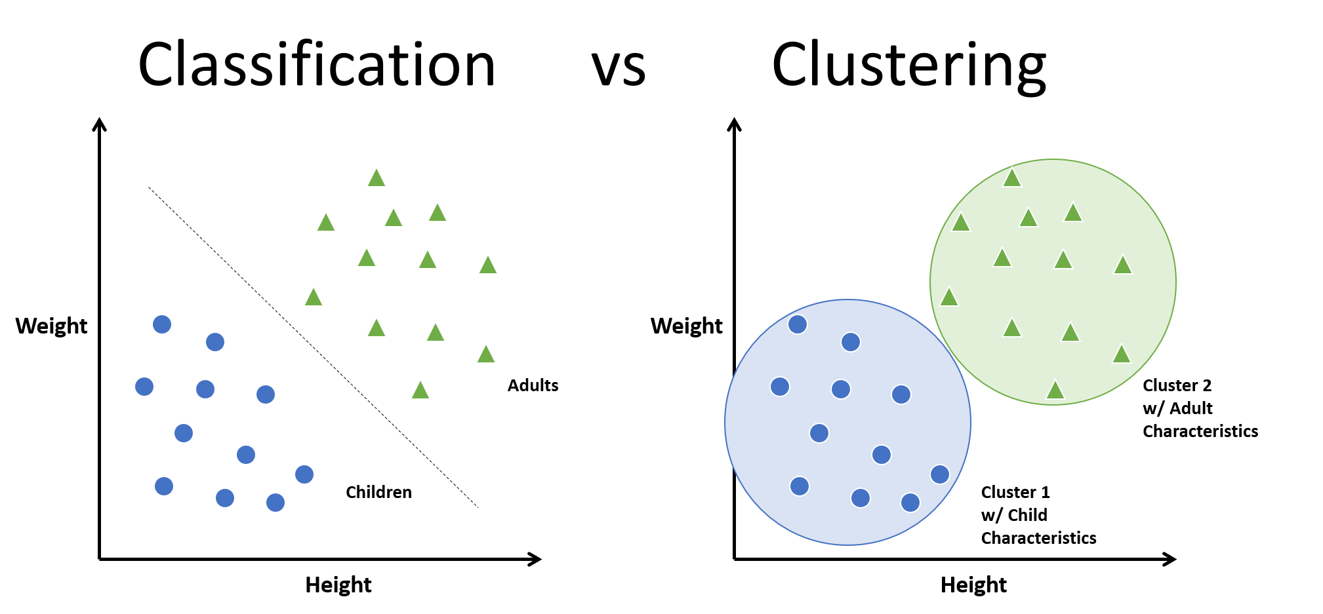
Model Selection & Training
Supervised Vs. Unsupervised Learning

Slide 6
Model Selection & Training
Classification Vs. Prediction
Classification
Models data where outcome variable is categorical (discrete or nominal)
Example: Classifying emails as Spam Vs. Ham
classifies data (constructs a model) based on the training set and the values (class labels: spam/ham) in a classifying attribute and uses it in classifying new data
Prediction
Models continuous-valued functions
Example: the house price prediction problem
Here, prediction involves housing prices, which are continuous real-valued numbers.
Use regression model since median house prices are available along with training data (predictors)

Slide 7
Model Selection and Training
What is Classification?
Consider the following examples:
A bank loans officer needs to analyze data to learn which loan applicants are "safe" and which are "risky" for the bank
A marketing manager at an electronics store wants to know whether a customer with a given profile will buy a new computer (Yes/No)
A medical researcher wants to analyze breast cancer data to predict which one of three specific treatments a patient should receive
Source: Data Mining Concepts & Techniques by Han, Kamber, & Pei

Slide 8
Model Selection and Training
What is Classification?
In each of these examples, the data analysis task is classification
Here, a model (or classifier) is constructed to predict class (categorical) labels, such as:
"safe" or "risky" for the loan application data
"yes" or "no" for the marketing data
"treatment A", "treatment B" or "treatment C" for the medical data
These categories can be represented by discrete values, where the ordering among values has no meaning
Source: Data Mining Concepts & Techniques by Han, Kamber, & Pei

Slide 9
Model Selection and Training
What is Prediction?
The data analysis may involve predicting a numeric value
E.g., the marketing manager wants to predict how much a given customer will spend during a sale at the Electronics Store
E.g., Organizations try to predict sales in the near and long term so that they can keep their inventory stocked appropriately.
Here, the model predicts a continuous-valued function, or ordered value, as opposed to a class label
This model is called a predictor
The statistical technique most often used for numeric prediction is Regression analysis

Slide 10
Model Selection and Training
What is Prediction?
For prediction, we lose the terminology of "class label attribute" because the attribute for which values are being predicted is continuous-valued (ordered) rather than categorical (discrete-valued and unordered).
The attribute can be referred to simply as the predicted attribute.
Suppose that, in our example of "safe" or "risky" for the loan application data, we instead wanted to predict the amount (in dollars) that would be "safe" for the bank to loan an applicant.
The task becomes prediction, rather than classification.
We would replace the categorical attribute, loan decision, with the continuous-valued loan amount as the predicted attribute, and build a predictor for our task.
Source: Data Mining Concepts & Techniques by Han, Kamber, & Pei

Slide 11

Model Selection & Training
Classification Vs. Prediction

Slide 12
Classification
A Two-Step Process
Model construction: describing a set of predetermined classes
Each tuple/sample is assumed to belong to a predefined class, as determined by the class label attribute
The set of tuples used for model construction is training set
The model is represented as classification rules, decision trees, or mathematical formulae
Model usage: for classifying future or unknown objects
Estimate accuracy of the model
The known label of test sample is compared with the classified result from the model
Accuracy rate is the percentage of test set samples that are correctly classified by the model
Test set is independent of training set, otherwise over-fitting will occur
If the accuracy is acceptable, use the model to classify data tuples whose class labels are not known

Slide 13
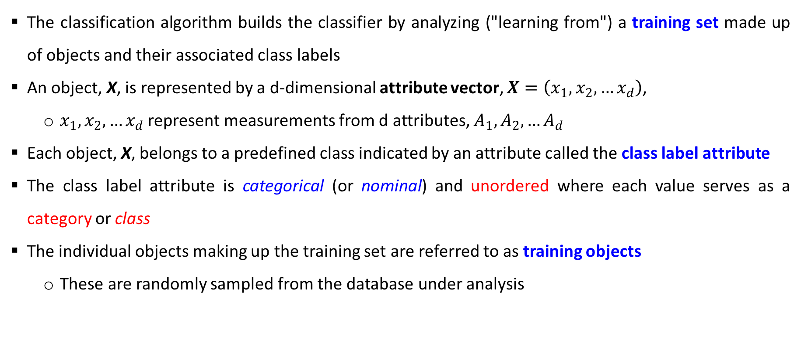
Classification
Learning Step
The classification algorithm builds the classifier by analyzing ("learning from") a training set made up of objects and their associated class labels
An object, X, is represented by a d-dimensional attribute vector, $X=\left(x_{1},x_{2},…x_{d}\right)$,
$x_{1},x_{2},…x_{d}$ represent measurements from d attributes, $A_{1},A_{2},…A_{d}$
Each object, X, belongs to a predefined class indicated by an attribute called the class label attribute
The class label attribute is categorical (or nominal) and unordered where each value serves as a category or class
The individual objects making up the training set are referred to as training objects
These are randomly sampled from the database under analysis

Slide 14
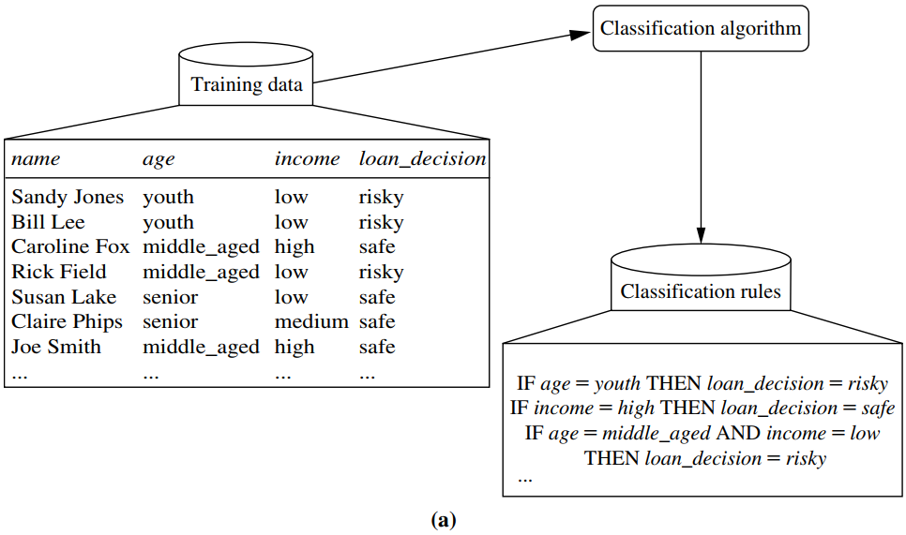
Classification
Learning Step
Training data are analyzed by a classification algorithm
Here,
the class label attribute is loan decision, and
the learned model or classifier is represented in the form of classification rules
Source: Data Mining Concepts & Techniques by Han, Kamber, & Pei

Slide 15
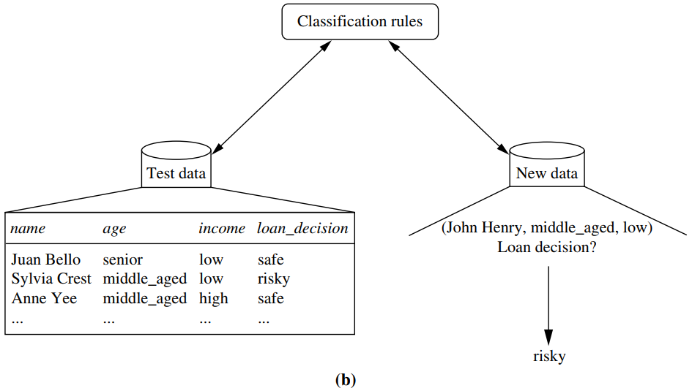
Classification
Classification Step
Test data are used to estimate the accuracy of the classification rules.
If the accuracy is considered acceptable, the rules can be applied to the classification of new data tuples
Source: Data Mining Concepts & Techniques by Han, Kamber, & Pei

Slide 16
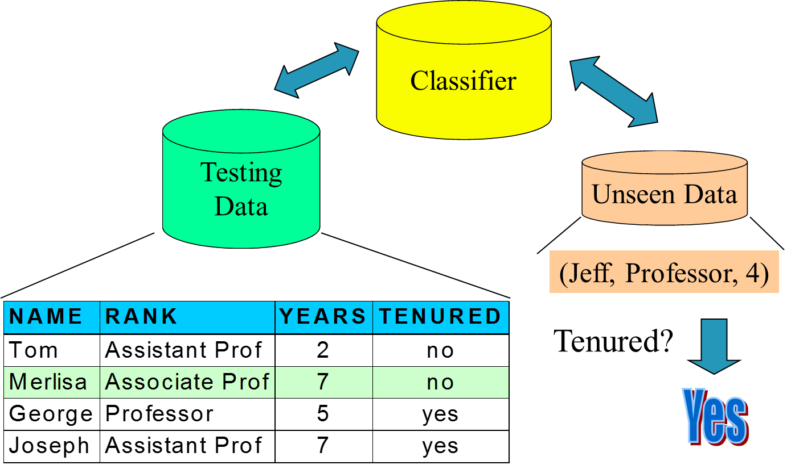
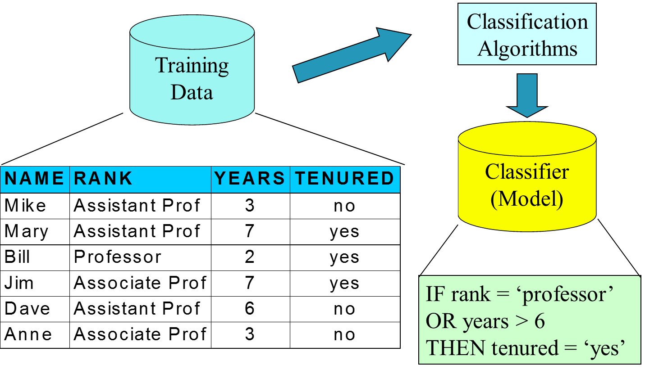
Classification
Illustrating Classification Task
Source: Data Mining Concepts & Techniques by Han, Kamber, & Pei

Slide 17
Classification
Illustrating Classification Task

Slide 18
Classification
Techniques used in Classification
Logistic Regression
Allows to model the probability of a particular event or class. It uses a logistic to model a binary dependent variable.
Decision Tree based Methods
It is a flowchart like structure. Here, every internal node refers to a test on a condition, and each branch stands for an outcome of the test (whether it’s true or false). Every leaf node in a decision tree holds a class label.
Neural Networks
computational networks that simulate the decision process in neurons (networks of nerve cell)
Naïve Bayes and Bayesian Belief Networks
uses the probability theory to find the most likely of the possible classifications
the algorithm assumes that every feature is independent of each other and that all the features contribute equally to the outcome.
Support Vector Machines
fits a boundary to a region of points that are all alike; uses the boundary to classify a new point

Slide 19
Classification
Lazy Vs. Eager Learning
Lazy learning (e.g., instance-based learning):
Simply stores training data (or only minor processing) and waits until it is given a test tuple
Less time in training but more time in predicting
Eager learning (the above discussed methods):
Given a set of training set, constructs a classification model before receiving new (e.g., test) data to classify
Accuracy
Lazy method effectively uses a richer hypothesis space since it uses many local linear functions to form its implicit global approximation to the target function
Eager: must commit to a single hypothesis that covers the entire instance space

Slide 20
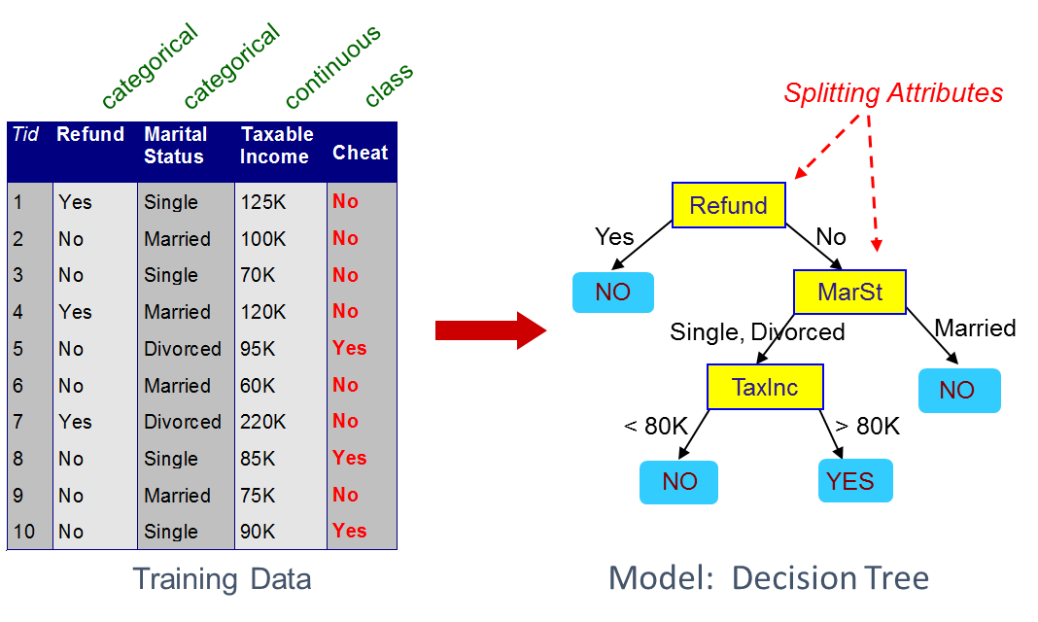
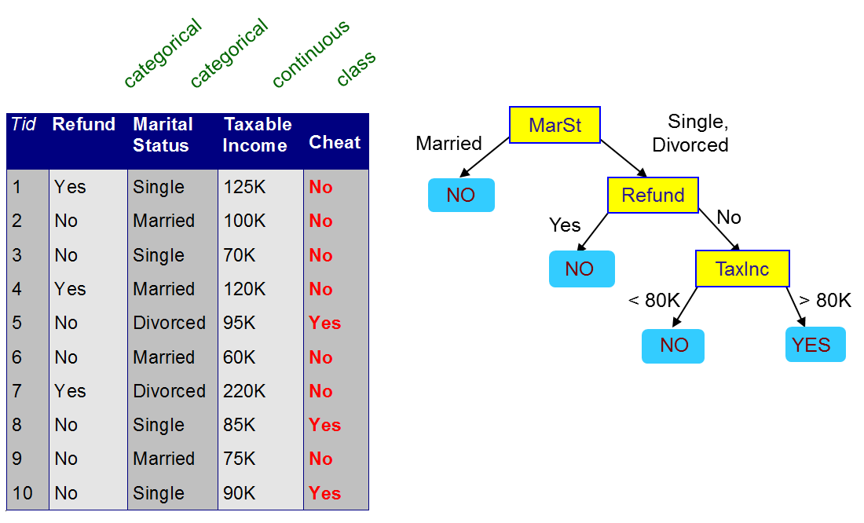
Classification
Decision Tree – Example
There could be more than one tree that fits the same data!
Source: Data Mining Concepts & Techniques by Han, Kamber, & Pei

Slide 21
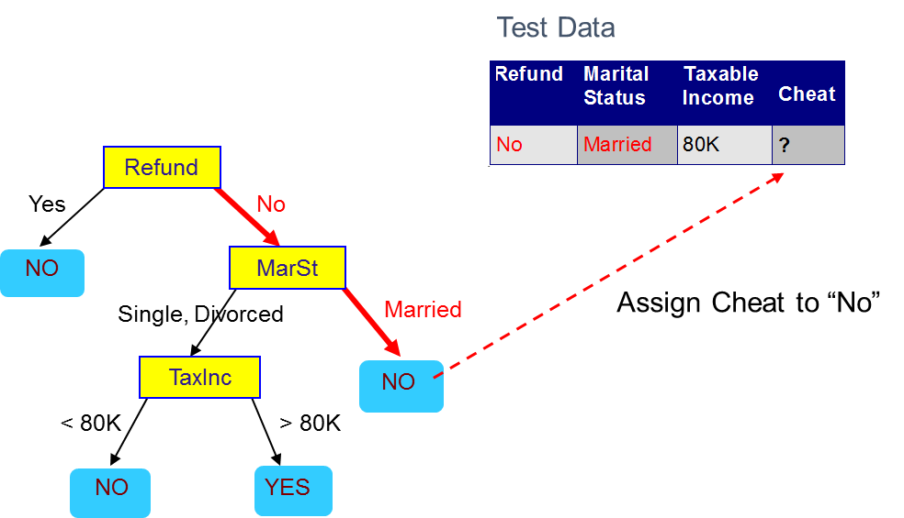
Classification
Apply Decision Tree Model to Test Data
Source: Data Mining Concepts & Techniques by Han, Kamber, & Pei

Slide 22
Classification
Decision Tree Classification Task
(Decision Tree)

Slide 23
Classification
Issues: Evaluating Classification Methods
Classification methods can be compared and evaluated according to the following criteria:
Accuracy
Speed
Robustness
Scalability
Interpretability
Note: This applies to prediction techniques as well.
Source: Data Mining Concepts & Techniques by Han, Kamber, & Pei

Slide 24
Classification
Issues: Evaluating Classification Methods
Accuracy
The accuracy of a classifier refers to the ability of a given classifier to correctly predict the class label of new or previously unseen data (i.e., tuples without class label information).
Similarly, the accuracy of a predictor refers to how well a given predictor can guess the value of the predicted attribute for new or previously unseen data.
We will discuss accuracy measures later in this module.
Accuracy can be estimated using one or more test sets that are independent of the training set.
Estimation techniques include techniques such as cross-validation and bootstrapping.
Because the accuracy computed is only an estimate of how well the classifier or predictor will do on new data tuples, confidence limits can be computed to help gauge this estimate.
Source: Data Mining Concepts & Techniques by Han, Kamber, & Pei

Slide 25
Classification
Issues: Evaluating Classification Methods
Speed:
This refers to the computational costs involved in generating and using the given classifier or predictor.
Robustness:
This is the ability of the classifier or predictor to make correct predictions given noisy data or data with missing values.
Scalability:
This refers to the ability to construct the classifier or predictor efficiently given large amounts of data.
Interpretability:
This refers to the level of understanding and insight that is provided by the classifier or predictor.
Interpretability is subjective and therefore more difficult to assess.
Source: Data Mining Concepts & Techniques by Han, Kamber, & Pei

Slide 26
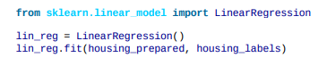
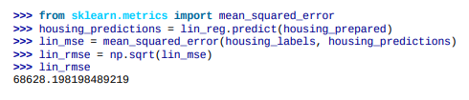
In this segment
Model Selection and Training
Select based on training data
If prediction label/output is available, use regression or classification model
Regression if real valued output
Classification if output is discrete (binary/integer)
else, unsupervised model is used.
For the house price prediction problem, use regression model since median house prices are available along with training data (predictors)
Example: Linear Regression
Better model is necessary for improving the prediction accuracy

Slide 27
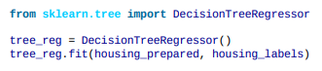
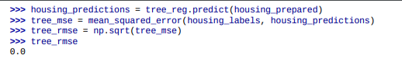
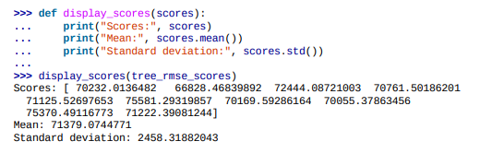
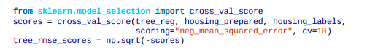
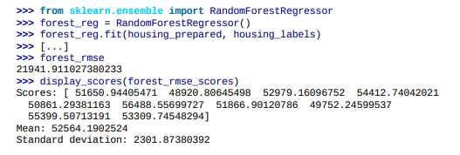
Regression Model Selection and Training
Decision Tree Based Regression produces low error on training data
Cross-validation error is not satisfactory
Better accuracy can be obtained using Random Forest based regressor

Slide 28
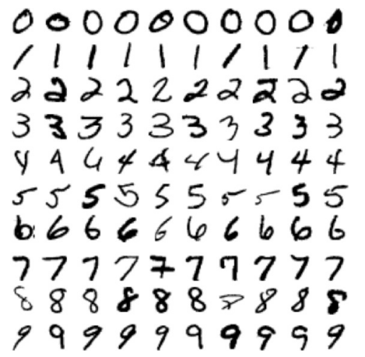
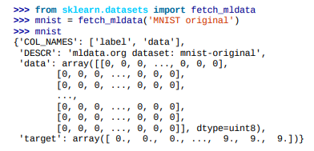

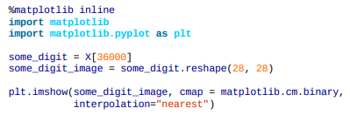
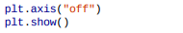
Classification Model
MNIST Dataset Classification
A set of 70,000 small images of handwritten digits
Each image 28x28 pixel with intensity 0 (black) – 255 (white)
Input data represented as 70000 x 784 matrix
Each image is labeled with the digit it represents.

Slide 29
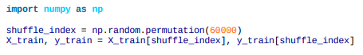
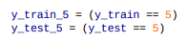
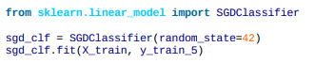
Classification Model Training
Detect a ‘5’
Segment the dataset into 60,000 training images and 10,000 test images
Shuffle the training dataset
Train a classification model for detecting ‘5’. Target output for training data instance corresponding an image of ‘5’ is +1, else target output is ‘0’
Perform cross validation like the regression problem and try out multiple classification model for achieving acceptable performance.

Slide 30
Multiclass Classification
Multiclass classifiers (aka multinomial classifiers) can distinguish between more than two classes.
Some algorithms (such as Random Forest classifiers or naive Bayes classifiers) are capable of handling multiple classes directly.
Many (such as Support Vector Machine classifiers or Linear classifiers) are strictly binary
One-versus-all (OvA) or One-versus-rest strategy using multiple binary classifiers.
e.g., for MNIST classification, train 10 binary classifiers, one for each digit (a 0-detector, a 1-detector, a 2-detector, and so on).
get the decision score from each classifier for that image and select the class whose classifier outputs the highest score.
One-versus-one (OvO) strategy
train a binary classifier for every pair of digits: one to distinguish 0s and 1s, another to distinguish 0s and 2s, another for 1s and 2s, and so on.
If there are N classes, you need to train N × (N – 1) / 2 classifiers.
Run an image through all 45 classifiers and see which class wins the most duels.
Main advantage of OvO is each classifier only needs to be trained on the part of the training set for the two classes that it must distinguish

Slide 31
Model Evaluation

Slide 32
Model Evaluation – Confusion Matrix
The confusion matrix is a useful tool for analyzing how well the classifier can recognize tuples of different classes
For two classes, a confusion matrix is a 2 by 2 table
TP and TN - Tell us when the classifier is getting things right
FP and FN - Tell us when the classifier is getting things wrong (i.e., mislabeling)
P is the number of tuples that are actually positive
N is the number of tuples that are actually negative
P' is the number of tuples that are predicted as positive (TP + FP)
N' is the number of tuples that are predicted as negative (TN + FN)
The total number of tuples
TP + TN + FP + TN = P + N = P' + N'
 |  | Predicted class |  | Total
 |  | Yes | No
Actual class | Yes | TP | FN | P
 | No | FP | TN | N
 |  | P' | N'

Slide 33
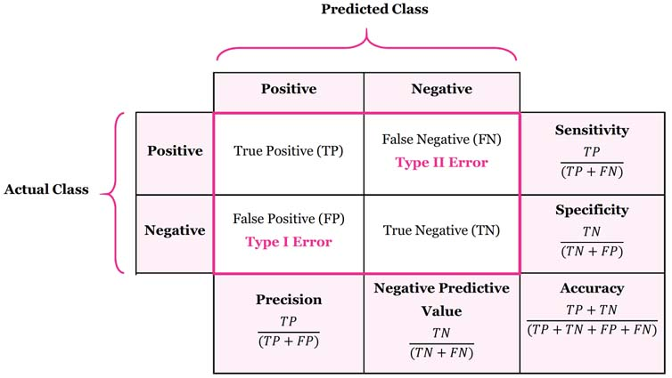
Model Evaluation – Confusion Matrix
Image: https://manisha-sirsat.blogspot.com/2019/04/confusion-matrix.html

Slide 34
Model Evaluation – Misclassification Error
1’s correctly classified as "1" = 201
1’s incorrectly classified as "0" = 85
0’s incorrectly classified as "1" = 25
0’s correctly classified as "0" = 2689
Misclassification
Error: classifying a record as belonging to one class when it belongs to another class
Error rate: percent of misclassified records out of the total records in the validation data

Slide 35
Model Evaluation – Cost Matrix
 | PREDICTED CLASS
ACTUAL CLASS | C(i | j) | Class=Yes | Class=No
 | Class=Yes | C(Yes|Yes) | C(No|Yes)
 | Class=No | C(Yes|No) | C(No|No)
C( i | j ): Cost of misclassifying class j example as class i

Slide 36
Model Evaluation – Computing cost of Classification
Model M₁ | PREDICTED CLASS
ACTUAL CLASS |  | + | -
 | + | 150 | 40
 | - | 60 | 250
Accuracy = 80%
Cost = 3910
Cost Matrix | PREDICTED CLASS
ACTUAL CLASS | C(i|j) | + | -
 | + | -1 | 100
 | - | 1 | 0
Model M₂ | PREDICTED CLASS
ACTUAL CLASS |  | + | -
 | + | 250 | 45
 | - | 5 | 200
Accuracy = 90%
Cost = 4255

Slide 37
Model Evaluation – Class Imbalance Problem
The class imbalance problem occurs when the main class of interest is rare
Examples:
Fraud detection applications
the class of interest (or positive class) is "fraud" occurs much less frequently than the negative "non-fraudulant" class
Medical data
rare class, such as "cancer"
suppose that we have trained a classifier to classify medical data tuples
Cancer = "Yes" or Cancer = "No"

Slide 38
Model Evaluation – Class Imbalance Problem
Accuracy rate of, say, 97%
may make the classifier seem quite accurate
what if only, say, 3% of the training tuples are actually cancer?
Here, an accuracy rate of 97% may not be acceptable, because
the classifier could be correctly labeling only the non-cancer tuples and misclassifying all the cancer tuples
In this case we need other measures, which assess how well the classifier can recognize the positive tuples (cancer = yes) and negative tuples (cancer = no)

Slide 39
Model Evaluation – Class Imbalance Problem
The class imbalance problem occurs when the main class of interest is rare
Examples:
Fraud detection applications
the class of interest (or positive class) is "fraud" occurs much less frequently than the negative "non-fraudulant" class
Medical data
rare class, such as "cancer"
suppose that we have trained a classifier to classify medical data tuples
Cancer = "Yes" or Cancer = "No"
Accuracy rate of, say, 97%
may make the classifier seem quite accurate
what if only, say, 3% of the training tuples are actually cancer?
Source: Data Mining Concepts & Techniques by Han, Kamber, & Pei

Slide 40
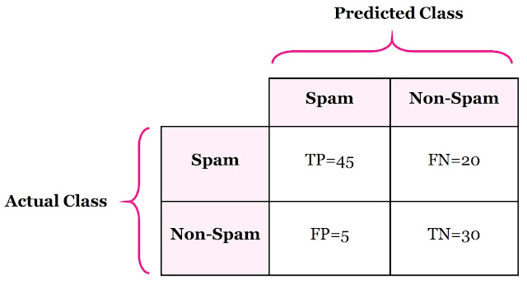
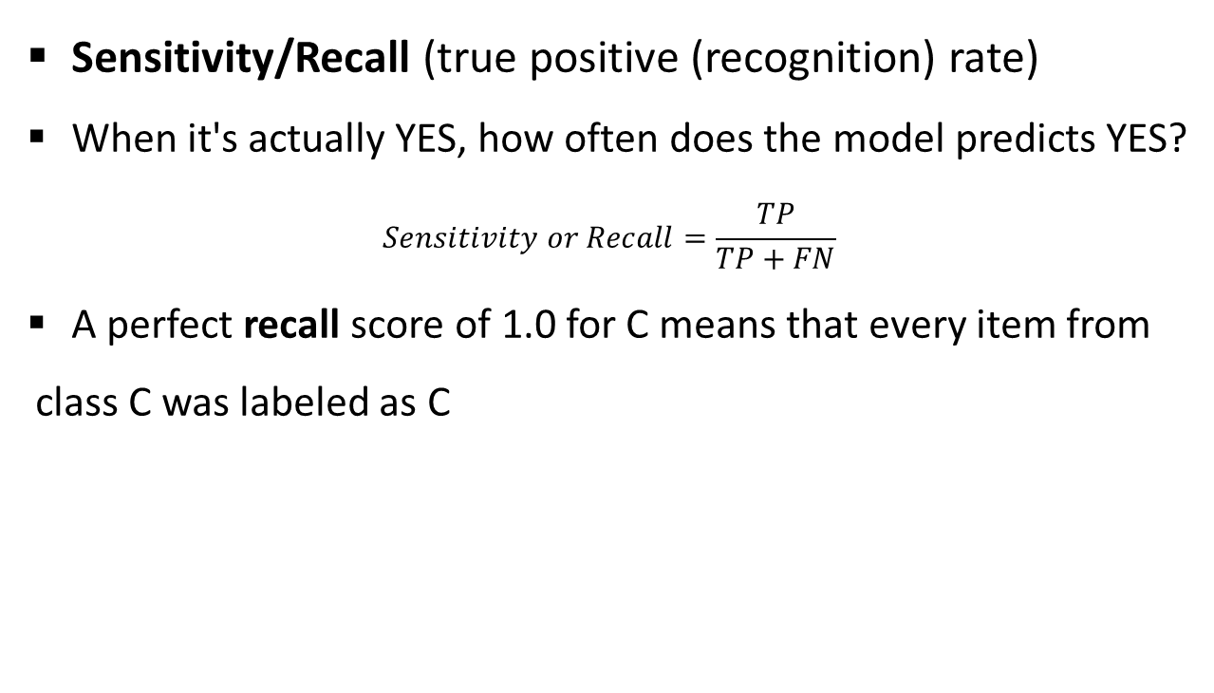
Model Evaluation – Class Imbalance Problem
 |  | Predicted class |  | Total
 |  | Yes | No
Actual class | Yes | TP | FN | P
 | No | FP | TN | N
 |  | P' | N'
Sensitivity/Recall (true positive (recognition) rate)
When it's actually YES, how often does the model predicts YES?
$$Sensitivity or Recall=\frac{TP}{TP+FN}$$
A perfect recall score of 1.0 for C means that every item from class C was labeled as C

Slide 41
Model Evaluation – Class Imbalance Problem
 |  | Predicted class |  | Total
 |  | Yes | No
Actual class | Yes | TP | FN | P
 | No | FP | TN | N
 |  | P' | N'
Sensitivity/Recall (true positive (recognition) rate)
Important when:
Identifying true positives is crucial
Used when:
The occurrence of false negatives is unacceptable/intolerable
We can rather have some extra false positives (false alarms) over saving some false negatives
E.g., when predicting deadly disease (cancer) or financial default

Slide 42
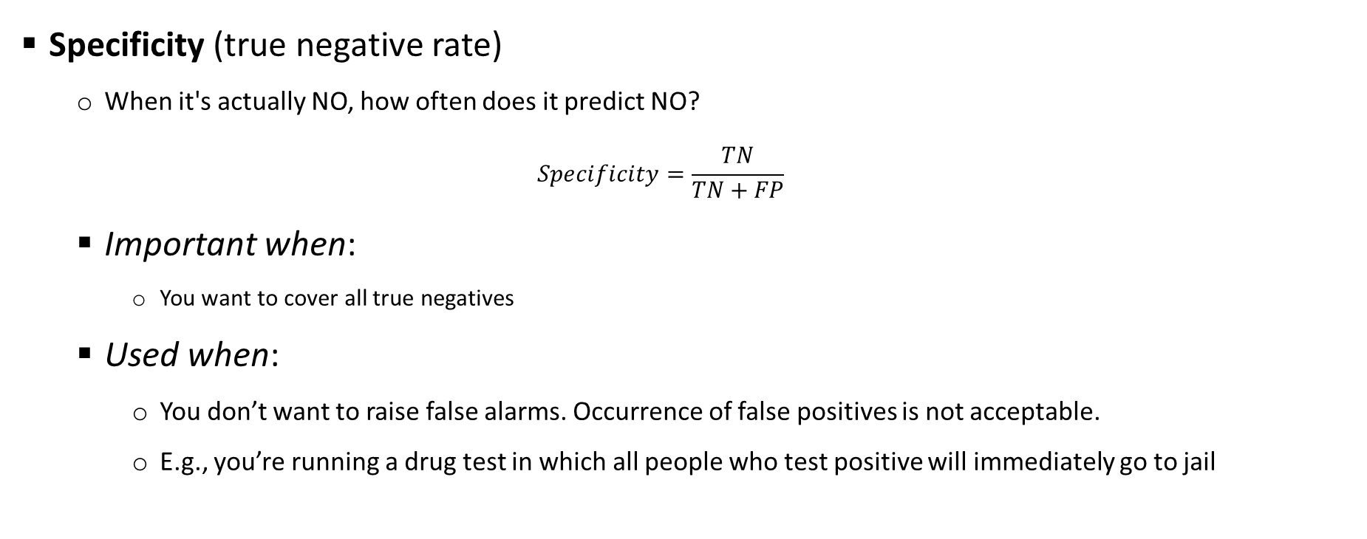
Model Evaluation – Class Imbalance Problem
Specificity (true negative rate)
When it's actually NO, how often does it predict NO?
$$Specificity=\frac{TN}{TN+FP}$$
Important when:
You want to cover all true negatives
Used when:
You don’t want to raise false alarms. Occurrence of false positives is not acceptable.
E.g., you’re running a drug test in which all people who test positive will immediately go to jail

Slide 43
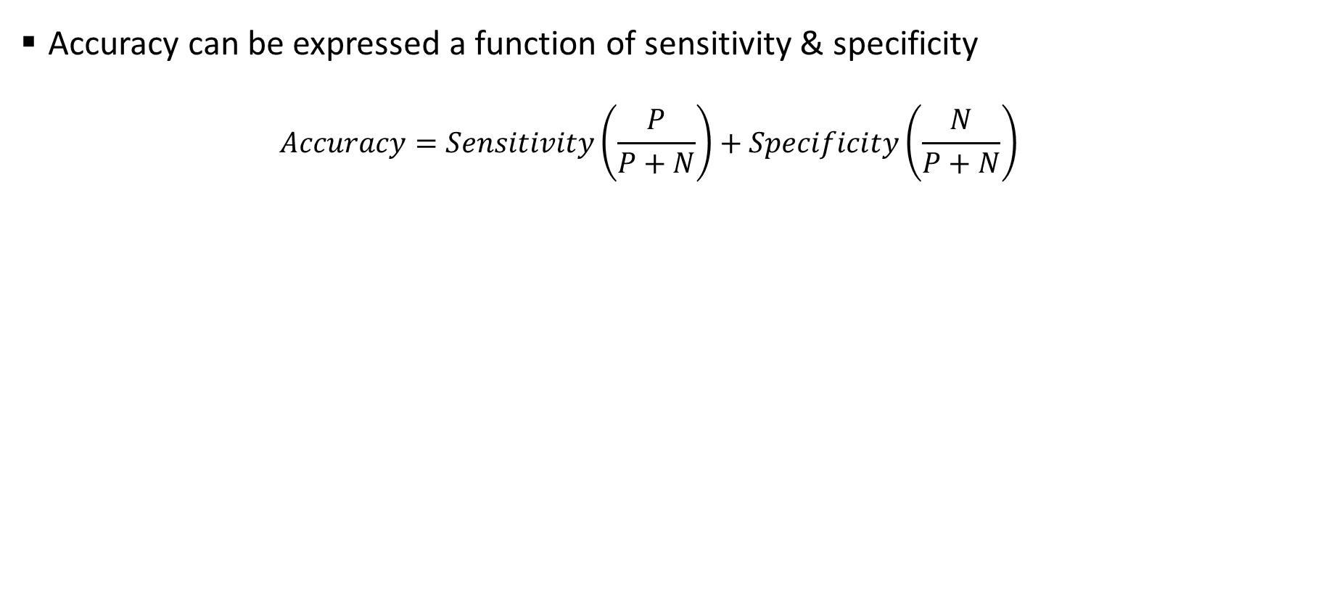
Model Evaluation – Class Imbalance Problem
Accuracy can be expressed a function of sensitivity & specificity
$$Accuracy=Sensitivity\left(\frac{P}{P+N}\right)+Specificity\left(\frac{N}{P+N}\right)$$
 |  | Predicted class |  | Total
 |  | Yes | No
Actual class | Yes | TP | FN | P
 | No | FP | TN | N
 |  | P' | N'

Slide 44
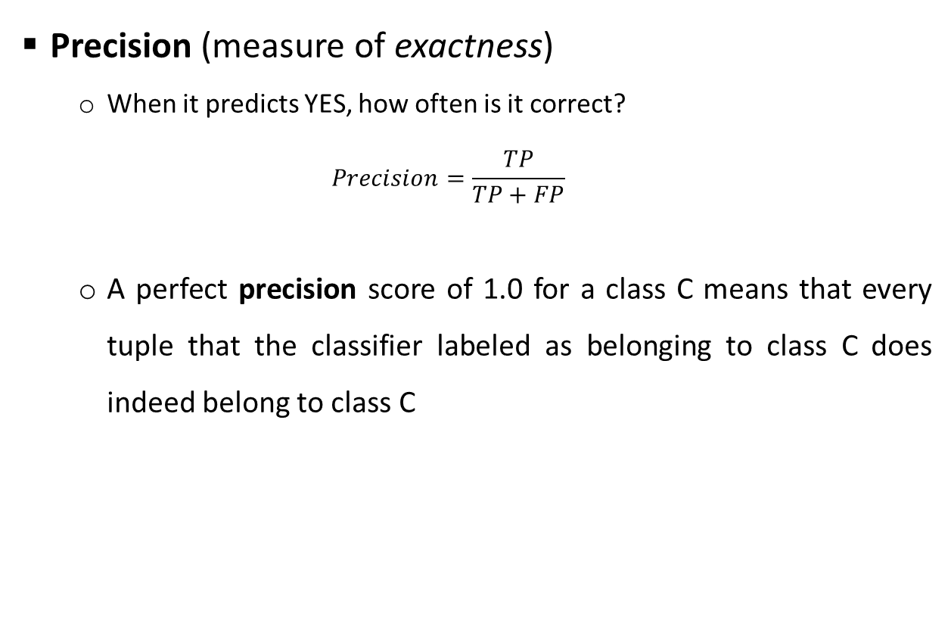
Model Evaluation – Class Imbalance Problem
Precision (measure of exactness)
When it predicts YES, how often is it correct?
$$Precision=\frac{TP}{TP+FP}$$
A perfect precision score of 1.0 for a class C means that every tuple that the classifier labeled as belonging to class C does indeed belong to class C
 |  | Predicted class |  | Total
 |  | Yes | No
Actual class | Yes | TP | FN | P
 | No | FP | TN | N
 |  | P' | N'

Slide 45
Model Evaluation – Class Imbalance Problem
Precision (measure of exactness)
Important when:
you want to be more confident of your predicted positives.
Used when:
the occurrence of false positives is unacceptable/intolerable
For example, Spam emails
We would rather have some spam emails in your inbox than miss out some regular emails that were incorrectly sent to your spam box.
Image: https://manisha-sirsat.blogspot.com/2019/04/confusion-matrix.html
Source: Data Mining Concepts & Techniques by Han, Kamber, & Pei

Slide 46
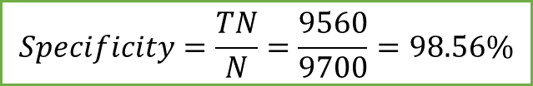
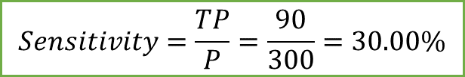
Model Evaluation – Class Imbalance Problem
Classes | Predicted class |  | Total | Recognition (%)
Actual class ⇓ | Yes | No
Yes | 90 | 210 | 300 | 30.00 (Sensitivity)
No | 140 | 9560 | 9700 | 98.56 (Specificity)
Total | 230 | 9770 | 10000 | 96.50 (Accuracy)
 |  | Predicted class |  | Total
 |  | Yes | No
Actual class | Yes | TP | FN | P
 | No | FP | TN | N
 |  | P' | N'
Confusion matrix for the classes cancer = yes and cancer = no
$$Sensitivity=\frac{TP}{P}=\frac{90}{300}=30.00\%$$
$$Specificity=\frac{TN}{N}=\frac{9560}{9700}=98.56\%$$
$$Overall Accuracy=30.00 ×\left(\frac{300}{10000}\right)+98.56 ×\left(\frac{9700}{10000}\right)=0.9+95.60=96.50$$
Source: Data Mining Concepts & Techniques by Han, Kamber, & Pei

Slide 47
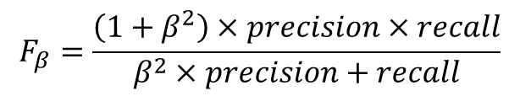
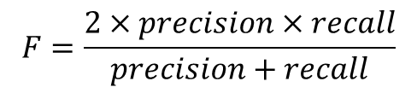
Model Evaluation – F Measure
F measure and F_{β} measure
An alternative way to use precision and recall is to combine them into a single measure
This is the approach of the F measure (also known as the F₁ score or F-score) and F_{β} measure
The F measure is the harmonic mean of precision and recall. It gives equal weight to precision and recall
Where
β is a non-negative real number
The F_{β} measure is a weighted measure of precision and recall. It assigns β times as much weight to recall as to precision
Commonly used F_{β} measures are:
F₂ (weights recall twice as much as precision) (False negative has more impart than false positive, choose a beta value greater than 1)
F_{0.5} (weights precision twice as much as recall) (False positive has more impact than false negative, you reduce beta value between 1 & 0)
$$F=\frac{2×precision×recall}{precision+recall}$$
$$F_{β}=\frac{\left(1+β^{2}\right)×precision×recall}{β^{2}×precision+recall}$$
Source: Data Mining Concepts & Techniques by Han, Kamber, & Pei

Slide 48
Model Evaluation
F measure and F_{β} measure
Important when:
you have an uneven class distribution.
Used when:
the cost of false positives and false negatives are different
F1 score
Is higher if there is a balance between Precision and Recall
F1 Score isn’t so high if one of these measures, Precision or Recall, is improved at the expense of the other.
Each one of these is defined in such a way that they capture different aspects of a model’s performance
When we are choosing one of these metrics to improve our model on, we need to keep in mind:
The problem that we are trying to solve
The dataset that we have with us (prevalence of each class in the data)
The cost that we have to pay for either types of misclassifications (false positives and false negatives)
Source: Data Mining Concepts & Techniques by Han, Kamber, & Pei

Slide 49
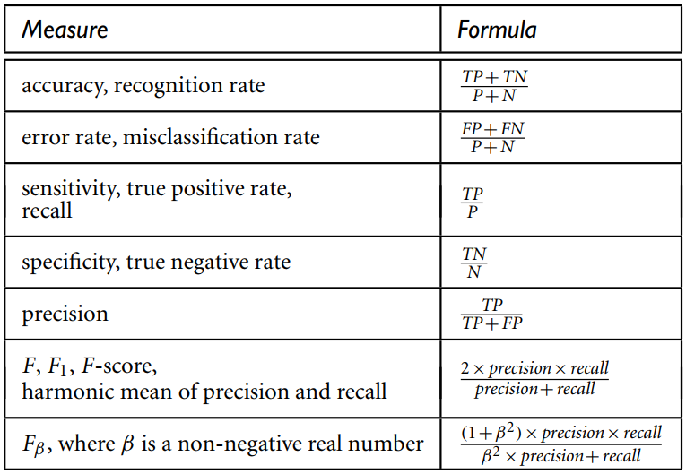
Model Evaluation - Summary
Two cases
The class tuples are more or less evenly distributed
Classes are unbalanced (e.g., where an important class of interest is rare such as in medical tests)
The classifier evaluation measures:
Accuracy (also known as recognition rate)
Sensitivity (or recall)
Specificity
Precision
F₁
F_{β}
Source: Data Mining Concepts & Techniques by Han, Kamber, & Pei

Slide 50
Methods of Evaluation

Slide 51
Methods of Evaluation – Data Selection Tech.
Holdout Method
In this method, given data are randomly partitioned into two independent sets:
Training set (2/3 of data) for model construction
Test set (1/3 of data) for accuracy estimation
The estimate is pessimistic because only a portion of the initial data is used to derive the model
Random subsampling
A variation of the holdout method
Here, the holdout method is repeated k times
The overall accuracy = average of accuracies obtained from each iteration

Slide 52
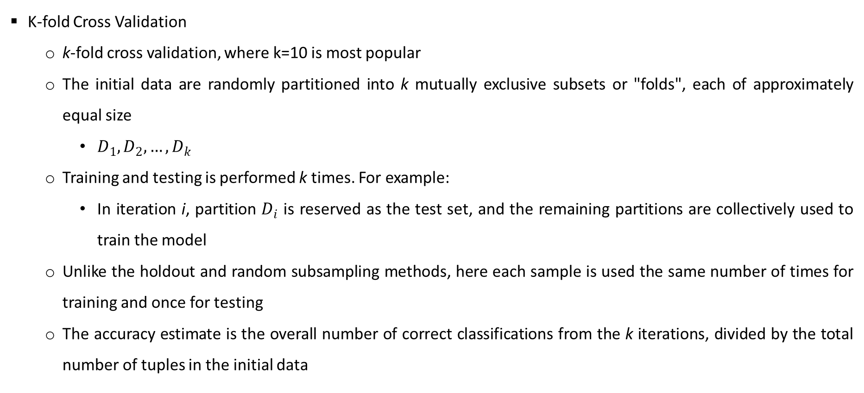
Methods of Evaluation - Data Selection Tech.
Data Selection Techniques
K-fold Cross Validation
k-fold cross validation, where k=10 is most popular
The initial data are randomly partitioned into k mutually exclusive subsets or "folds", each of approximately equal size
$D_{1},D_{2},…,D_{k}$
Training and testing is performed k times. For example:
In iteration i, partition $D_{i}$ is reserved as the test set, and the remaining partitions are collectively used to train the model
Unlike the holdout and random subsampling methods, here each sample is used the same number of times for training and once for testing
The accuracy estimate is the overall number of correct classifications from the k iterations, divided by the total number of tuples in the initial data

Slide 53
Methods of Evaluation - Data Selection Tech.
Data Selection Techniques
Cross Validation
Leave-one-out
A special case of k-fold cross-validation where k is set to the number of initial tuples
That is, only one sample is "left out" at a time for the test set
Stratified cross-validation
The folds are stratified so that the class distribution of the tuples in each fold is approximately the same as that in the initial data
In general, stratified 10-fold cross-validation is recommended for estimating accuracy
due to its relatively low bias and variance
Source: Data Mining Concepts & Techniques by Han, Kamber, & Pei

Slide 54
Methods of Evaluation - Data Selection Tech.
Data Selection Techniques
Bootstrap
Samples the given training tuples uniformly with replacement
Commonly used bootstrap method is the .632 bootstrap
On average, 63.2% of the original data tuples will end up in the bootstrap sample, and the remaining 36.8% will form the test set.
Where does the figure, 63.2%, come from?
For each tuple:
probability getting selected = 1/d
probability of not being chosen is (1 – 1/d)
if you select d times probability that a tuple will not be chosen during this whole time is (1 – 1/d)^{d}
for a large d, the probability approaches e⁻¹ = 0.368
Thus, 36.8% of tuples will not be selected (remaining 63.2% will form the training set)
Source: Data Mining Concepts & Techniques by Han, Kamber, & Pei

Slide 55
ROC Curves

Slide 56
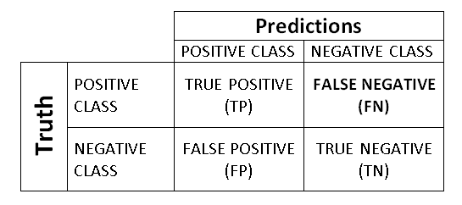
ROC Curves
History
Originated from signal detection theory
Applied in WW2 Battle of Britain to address:
Accurately identifying the signals on the radar scan to predict the outcome of interest – Enemy planes – when there were many extraneous signals (e.g. Geese)?
True Positives
Radar Operator interpreted signal as Enemy Planes and there were Enemy planes (Good Result: No wasted Resources)
True Negatives
Radar Operator said no planes and there were none (Good Result: No wasted resources)
False Positives
Radar Operator said planes, but there were none (Geese: wasted resources)
False Negatives
Radar Operator said no plane, but there were planes (Bombs dropped: very bad outcome)

Slide 57
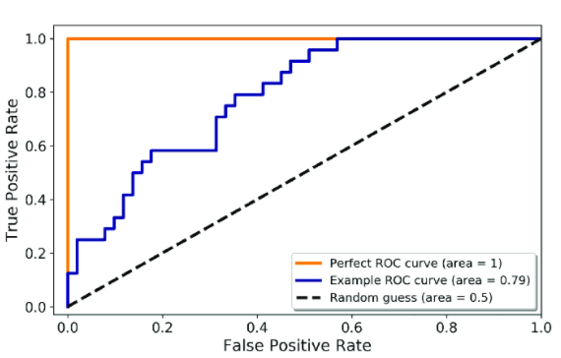
ROC Curves
Overview
ROC curves are a useful visual tool for comparing two binary classification models
Given TP, TN, FP, & FN
TPR is the proportion of positive (or "yes") tuples that are correctly labeled by the model
= TP/(TP+FN), which is sensitivity
FPR is the proportion of negative (or “no”) tuples that are mislabeled as positive
= FP/(FP+TN) , which is 1 − specificity
An ROC curve for a given model shows the trade-off between the true positive rate (TPR) and the false positive rate (FPR)
Source: Data Mining Concepts & Techniques by Han, Kamber, & Pei

Slide 58
ROC Curves
Optimal Probability Threshold
Consider an email classification model that detects suspicious communication between terrorists over regular email
Here, terrorist email is Class YES and a non-terrorist email is Class NO
It is absolutely necessary for the model to identify the terrorists’ emails correctly (True Positive Rate)
That is, we choose Sensitivity as a metric to improve this model because
the occurrence of false negatives is unacceptable
In this pursuit, we might end up having a few false positives/false alarms but that might be a compromise that we’ll have to make.
Let us say we develop 2 good models which have the same Sensitivity score
Does that mean the two models have equal predictive power? NO
Source: Analytics Vidhya - How to select Performance Metrics for Classification Models

Slide 59
ROC Curves
Optimal Probability Threshold
Most classification algorithms predict the probability that an observation belongs to class YES
We need to decide a threshold for these probabilities, to classify the observations into one of the two classes
The observation having probability higher than the threshold are classified as class YES.
For example:
the model predicts the probability of an email being a terrorist email as 0.75
If we set the threshold as 0.8, then we will classify this email as non-terrorist email
If we set the threshold as 0.7, then we will classify the email as a terrorist email
So, the performance of our system would vary as we change this threshold
This threshold can be adjusted to tune the behavior of the model for a specific problem
That is, we can reduce more of one or another type of error (FP/FN).
Source: Analytics Vidhya - How to select Performance Metrics for Classification Models

Slide 60
ROC Curves
Optimal Probability Threshold
Two models with the same sensitivity (TPR) are not equivalent
Among these two, the model with a lower FPR is obviously a better, more reliable model
We do not want to waste any of our investigative resources on non-terrorist emails that were misclassified as terrorist emails
The threshold that we set, can help us increase or decrease the TPR
If we choose a low threshold, more emails will be classified as terrorist emails, we will be able to catch more true positives but then even the false positive rate would increase
The choice of threshold entails a trade-off between false positives and false negatives.
An ROC curve is a useful resource in this regard.
Source: Analytics Vidhya - How to select Performance Metrics for Classification Models

Slide 61
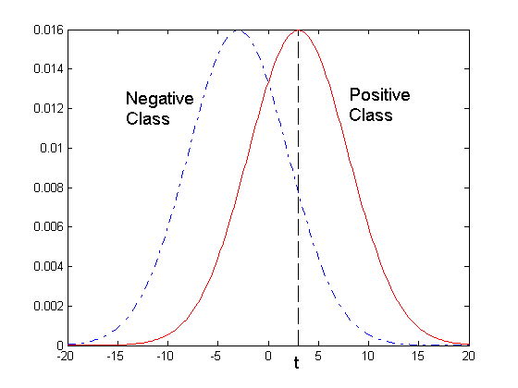
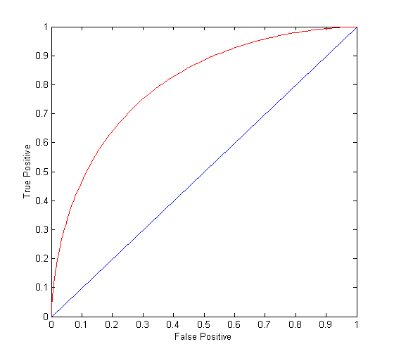
ROC Curves
Optimal Probability Threshold
1-dimensional data set containing 2 classes (positive and negative)
any points located at x > t is classified as positive
At threshold t:
TP=0.5, FN=0.5, FP=0.12, TN=0.88

Slide 62
ROC Curves
Optimal Probability Threshold
(TP, FP):
(0,0): declare everything to be negative class
(1,1): declare everything to be positive class
(1,0): ideal
Diagonal line:
Random guessing
Below diagonal line:
prediction is opposite of the true class

Slide 63
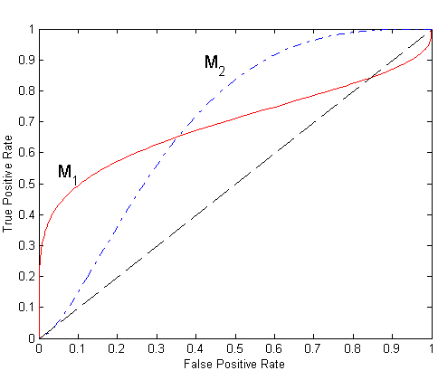
ROC Curves
Optimal Probability Threshold
No model consistently outperforms the other
M₁ is better for small FPR
M₂ is better for large FPR
Area Under the ROC curve
Ideal:
Area = 1
Random guess:
Area = 0.5

Slide 64
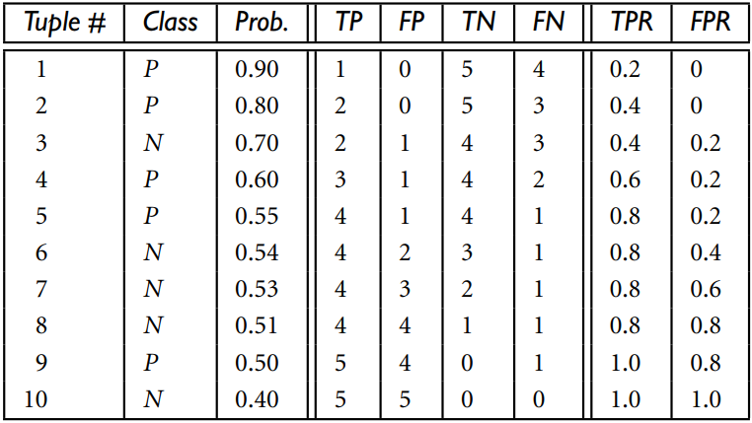
ROC Curves
Example
0.90 |  | Predicted
 |  | Yes | No
Actual | Yes | 1 | 4
 | No | 0 | 5
0.80 |  | Predicted
 |  | Yes | No
Actual | Yes | 2 | 3
 | No | 0 | 5
0.70 |  | Predicted
 |  | Yes | No
Actual | Yes | 2 | 3
 | No | 1 | 4
0.60 |  | Predicted
 |  | Yes | No
Actual | Yes | 3 | 2
 | No | 1 | 4
0.55 |  | Predicted
 |  | Yes | No
Actual | Yes | 4 | 1
 | No | 1 | 4
0.54 |  | Predicted
 |  | Yes | No
Actual | Yes | 4 | 1
 | No | 2 | 3
0.53 |  | Predicted
 |  | Yes | No
Actual | Yes | 4 | 1
 | No | 3 | 2
0.51 |  | Predicted
 |  | Yes | No
Actual | Yes | 4 | 1
 | No | 4 | 1
0.50 |  | Predicted
 |  | Yes | No
Actual | Yes | 5 | 0
 | No | 4 | 1
Source: Data Mining Concepts & Techniques by Han, Kamber, & Pei

Slide 65
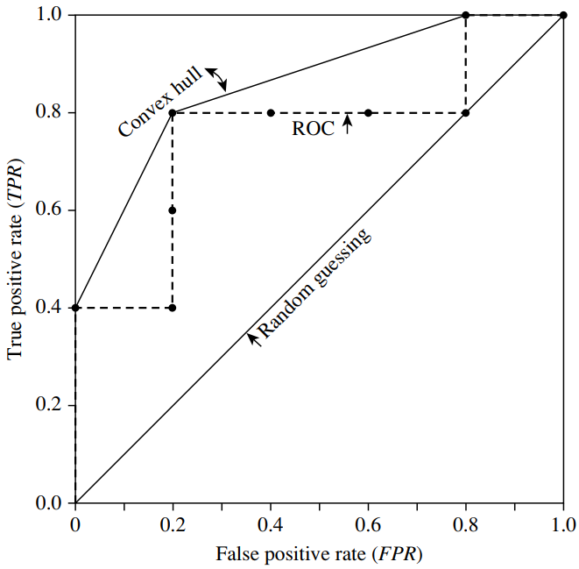
ROC Curves
Example
Source: Data Mining Concepts & Techniques by Han, Kamber, & Pei

Slide 66
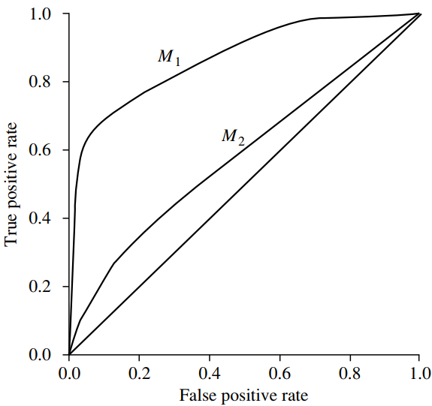
ROC Curves
Comparison between two models
For a two-class problem, an ROC curve allows us to visualize the trade-off between the rate at which the model can accurately recognize positive cases versus the rate at which it mistakenly identifies negative cases as positive for different portions of the test set
Any increase in TPR occurs at the cost of an increase in FPR
The area under the ROC curve is a measure of the accuracy of the model
The closer to the diagonal line (i.e., the closer the area is to 0.5), the less accurate is the model
Source: Data Mining Concepts & Techniques by Han, Kamber, & Pei

Slide 67
Hyperparameters
Machine Learning systems use many parameters internally
Gradient Descent
e.g., Learning rate, how long to run
Mini-batch
Batch size
Regularization constant

Slide 68
Machine Learning Pipeline

Slide 69
What is MLOps?
Apply DevOps principles to ML systems
An engineering culture and practice that aims at unifying ML system development (Dev) and ML system operation (Ops).
Automation and monitoring at all steps of ML system construction, including integration, testing, releasing, deployment and infrastructure management.
Data scientists can implement and train an ML model with predictive performance on an offline validation (holdout) dataset, given relevant training data for their use case.
However, the real challenge is building an integrated ML system and to continuously operate it in production.

Slide 70
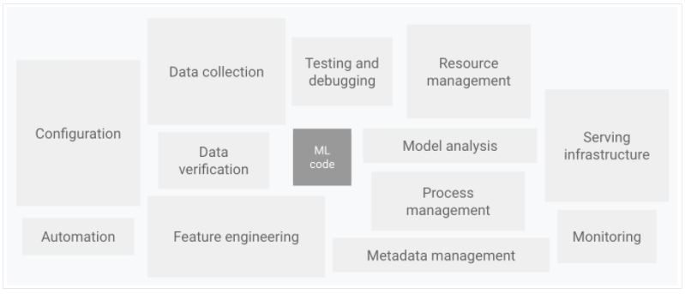
Ecosystem of ML System Components
A small fraction of a real-world ML system is composed of the ML code

Slide 71
DevOps Vs. MLOps
DevOps for developing and operating large-scale software systems provides benefits such as
shortening the development cycles
increasing deployment velocity, and
dependable releases.
Two key concepts
Continuous Integration (CI)
Continuous Delivery (CD)
An ML system is a software system, so similar practices apply to reliably build and operate at scale.
However, ML systems differ from other software systems
Team skills: focus on exploratory data analysis, model development, and experimentation.
Development: ML is experimental in nature.
The challenge is tracking what worked and what did not, maintaining reproducibility, and maximizing code reusability.
Testing: Additional testing needed for data validation, trained model quality evaluation, and model validation.

Slide 72
DevOps Vs. MLOps
Deployment: a multi-step pipeline to automatically retrain and deploy model.
adds complexity
Automation needed before deployment by data scientists to train and validate new models.
Production: ML models can have reduced performance due to constantly evolving data profiles.
Need to track summary statistics of data and
monitor the online performance of model to send notifications or roll back for suboptimal values
ML and other software systems are similar in CI of source control, unit / integration testing, and CD of the software module / package.
However, in ML,
CI is also about testing and validating data, data schemas, and models.
CD is a system (an ML training pipeline) that automatically deploys another service (model prediction service).
Continuous training (CT) is a new property, unique to ML systems, that is concerned with automatically retraining the model in production and serving the models.

Slide 73
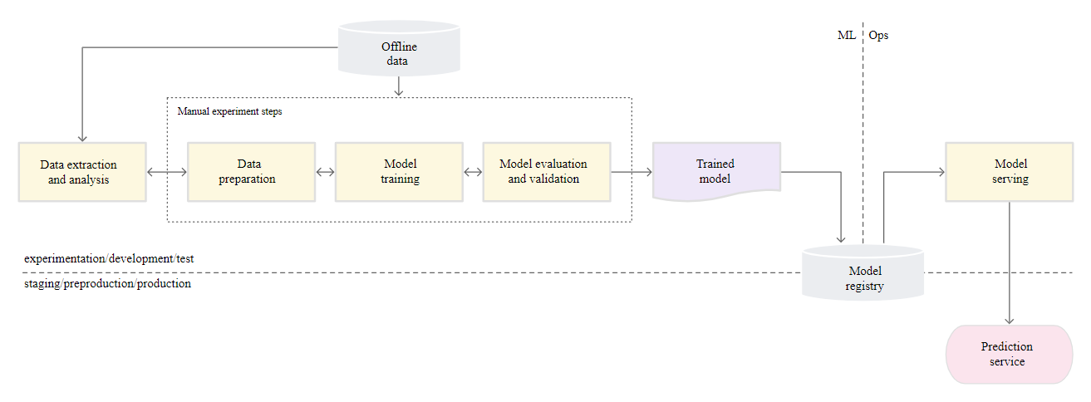
Manual ML Steps
Manual, script-driven, and interactive process.
Disconnection between ML and operations, possibly leading to training-serving skew
Infrequent release iterations. No CI, CD, active performance monitoring
Deploy trained Model as a prediction service
Deployment process is concerned only with deploying the trained model as a prediction service, e.g., a microservice with a REST API

Slide 74
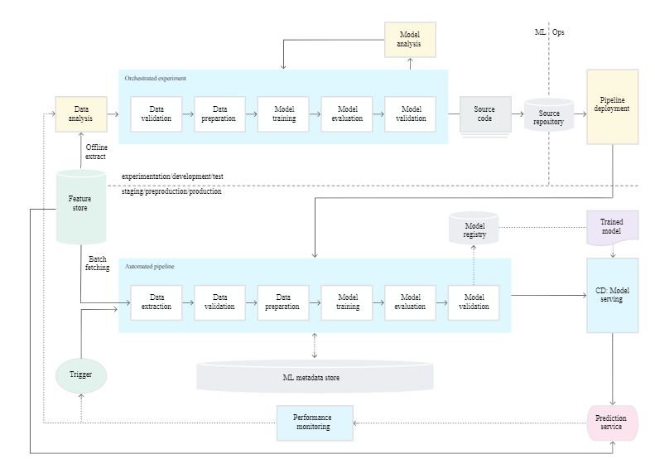
MLOps Level 1
Perform continuous training (CT) by automating the ML pipeline
Achieves continuous delivery of model prediction service.
Automated data and model validation steps to the pipeline
Needs pipeline triggers and metadata management.

Slide 75
Data and Model Validation
Data validation: Required prior to model training to decide whether to retrain the model or stop the execution of the pipeline based on following
Data values skews: significant changes in the statistical properties of data, triggering retraining
Data schema skews: downstream pipeline steps, including data processing and model training, receives data that doesn't comply with the expected schema.
stop the pipeline to release a fix or an update to the pipeline to handle these changes in the schema.
Schema skews include receiving unexpected features or with unexpected values, not receiving all the expected features
Model validation: Required after retraining the model with the new data. Evaluate and validate the model before promoting to production. This offline model validation step consists of
Producing evaluation metric using the trained model on test data to assess the model quality.
Comparing the evaluation metrics of production model, baseline model, or other business-requirement models.
Ensuring the consistency of model performance on various data segments
Test model for deployment, including infrastructure compatibility and API consistency
Undergo online model validation—in a canary deployment or an A/B testing setup

Slide 76
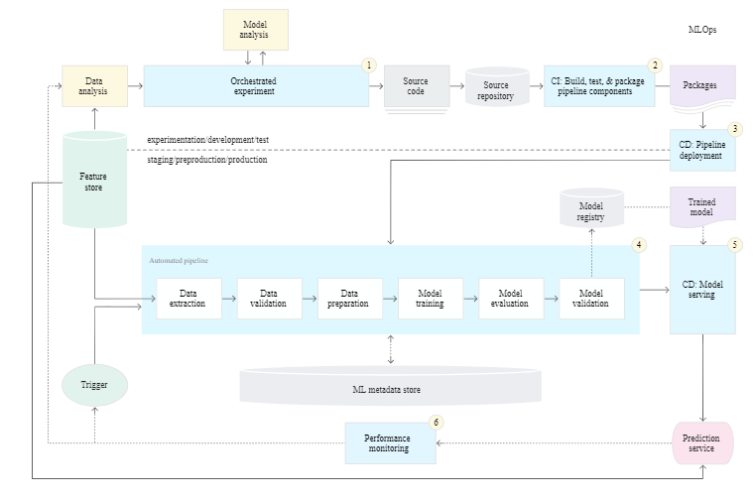
Level 2: CI/CD and automated pipeline automation
Notes:
Enables rapid and reliable update of the pipelines in production.
Enables rapid exploration of new ideas around feature engineering, model architecture, and hyperparameters.
They can implement these ideas and automatically build, test, and deploy the new pipeline components to the target environment.

Slide 77
Stages of CI/CD Automation Pipeline
Development and experimentation: iteratively try new ML algorithms and modeling. The output is the source code of the ML pipeline steps that are then pushed to a source repository.
Pipeline continuous integration: build source code and run various tests. The outputs of this stage are pipeline components (packages, executables, and artifacts).
Pipeline continuous delivery: deploy artifacts produced by the CI stage to the target environment.
Automated training: automatically executed in production based on a schedule or trigger. The output is a trained model pushed to the model registry.
Model continuous delivery: serve the trained model as a prediction service for the predictions.
Monitoring: collect statistics on the model performance based on live data. The output is a trigger to execute the pipeline or to execute a new experiment cycle.

Slide 78
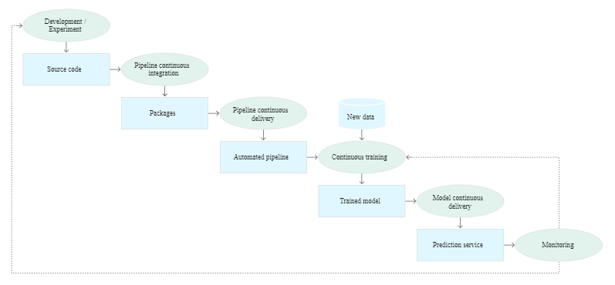
Stages of the CI/CD automated ML pipeline

Slide 79
Continuous Integration
Pipeline and its components are built, tested, and packaged when
new code is committed or
pushed to the source code repository.
Besides building packages, container images, and executables, CI process can include
Unit testing feature engineering logic.
Unit testing the different methods implemented in your model.
For example, you have a function that accepts a categorical data column and you encode the function as a one-hot feature.
Testing for training convergence
Testing for NaN values due to dividing by zero or manipulating small or large values.
Testing that each component in the pipeline produces the expected artifacts.
Testing integration between pipeline components.

Slide 80
Continuous Delivery
Continuously delivers new pipeline implementations to the target environment
prediction services of the newly trained model.
For rapid and reliable continuous delivery of pipelines and models, consider
Verifying the compatibility of the model with the target infrastructure
e.g., required packages are installed in the serving environment
Availability of memory, compute, and accelerator resources.
Testing the prediction service by calling the service API for the updated model
Testing prediction service performance, such as throughput, latency.
Validating the data either for retraining or batch prediction.
Verifying that models meet the predictive performance targets prior to deployment.
Automated deployment to a test environment, triggered by new code to the development branch.
Semi-automated deployment to a pre-production environment, triggered by code merging
Manual deployment to a production from pre-production.

Slide 81
Frameworks
Cloud Vendors are providing MLOps framework
https://cloud.google.com/solutions/machine-learning/mlops-continuous-delivery-and-automation-pipelines-in-machine-learning
Kubeflow and Cloud Build
Amazon AWS MLOps
Microsoft Azure MLOps

Slide 82
Thank You!

